Slide 1
How can a Wellness Company play it smart?
By Paa kofi Boafo

Slide 2
Agenda
Objective
Data used
Findings
Recommendations
Questions

Slide 3
Objective
To analyze how non consumers of BellaBeat use other smart devices by analyzing data from those devices

Slide 4
Data used
Source: FitBit Fitness Tracker Data
Period: 4/12/16 - 5/12/16

Slide 5
Findings
Average steps were 7638 with an average total distance of 5.49km and average calories of 2303
Average sedentary minutes was 991.2 and average of Very active minutes is 21.16
Average steps were below the recommended 10,000 and average distance was below the recommended 8km

Slide 6
Findings
Most of the fields for recorded Fat information was empty, so it was not used
Average BMI was 25.19
According to the CDC, the average adult man has a BMI of 26.6 and the average adult woman has a BMI of 26.5 in the US
Healthy BMI ranges are between 18 and 24.9

Slide 7
Findings
Total sleep records added up to 462
Average sleep time was 374 minutes
Average time in bed was 409
People spent about 35 minutes awake before sleeping

Slide 8
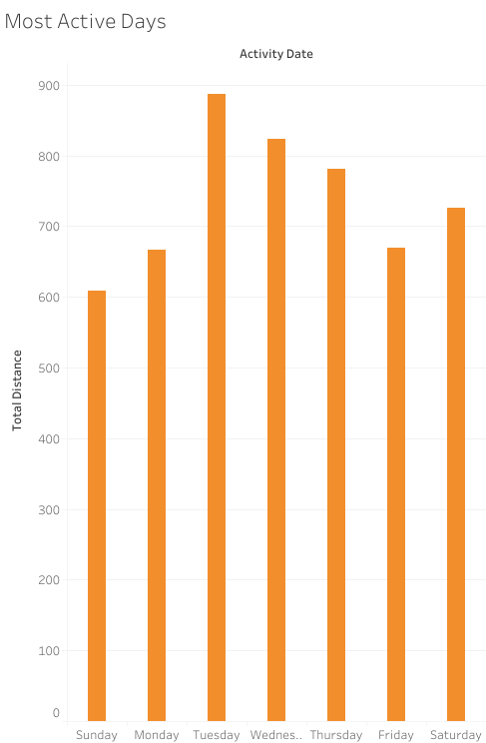
Findings
Notes:
As we can see, the average user travelled a longer distance on tuesday than other days with sunday being the least

Slide 9
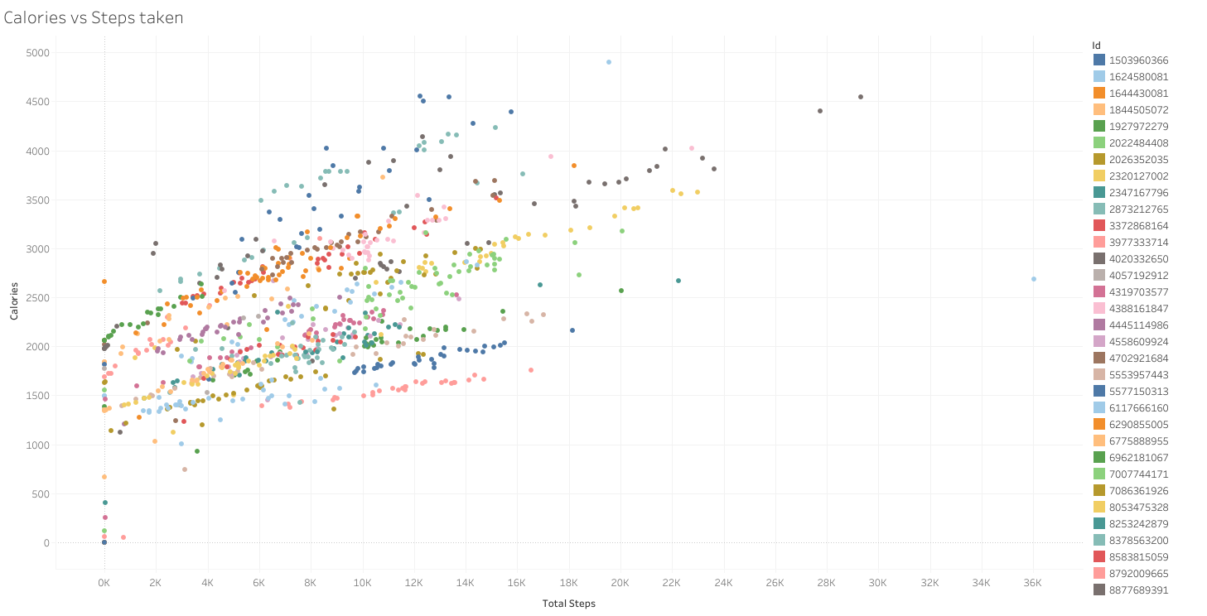
Findings
Notes:
Based off the trend, the number of total steps is directly proportional to the calories burned

Slide 10
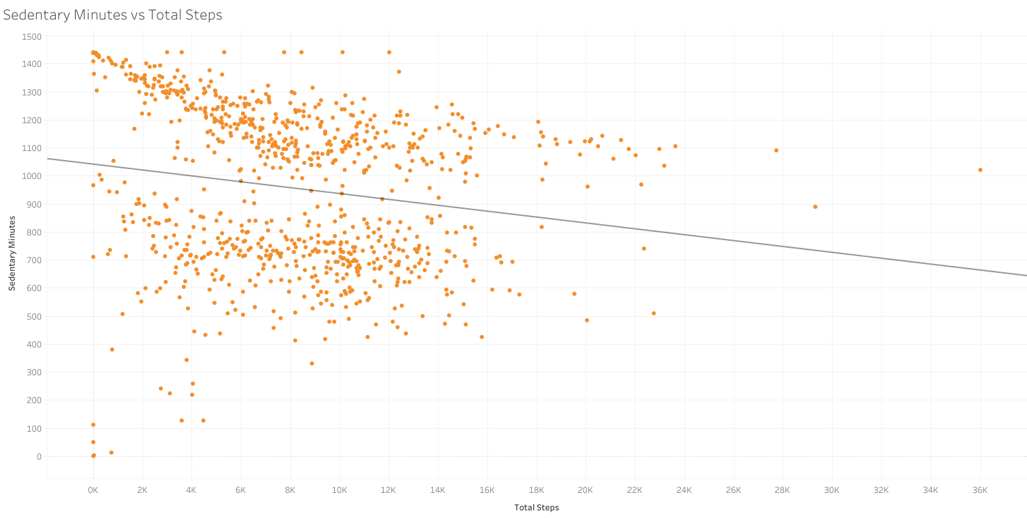
Findings
Notes:
The data shows a downward trend between the total steps and sedentary minutes
People with the least steps had higher sedentary minutes
However as the number of steps gets higher past the 8k point, the difference is not as drastic

Slide 11
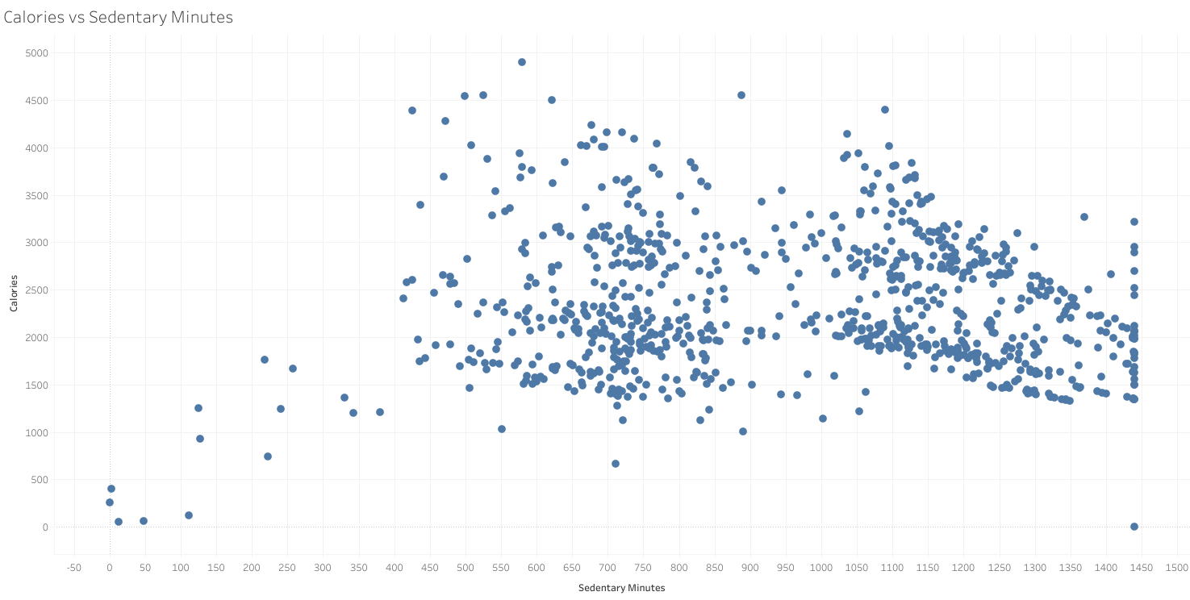
Findings
Notes:
Calories vs Sedentary minutes

Slide 12
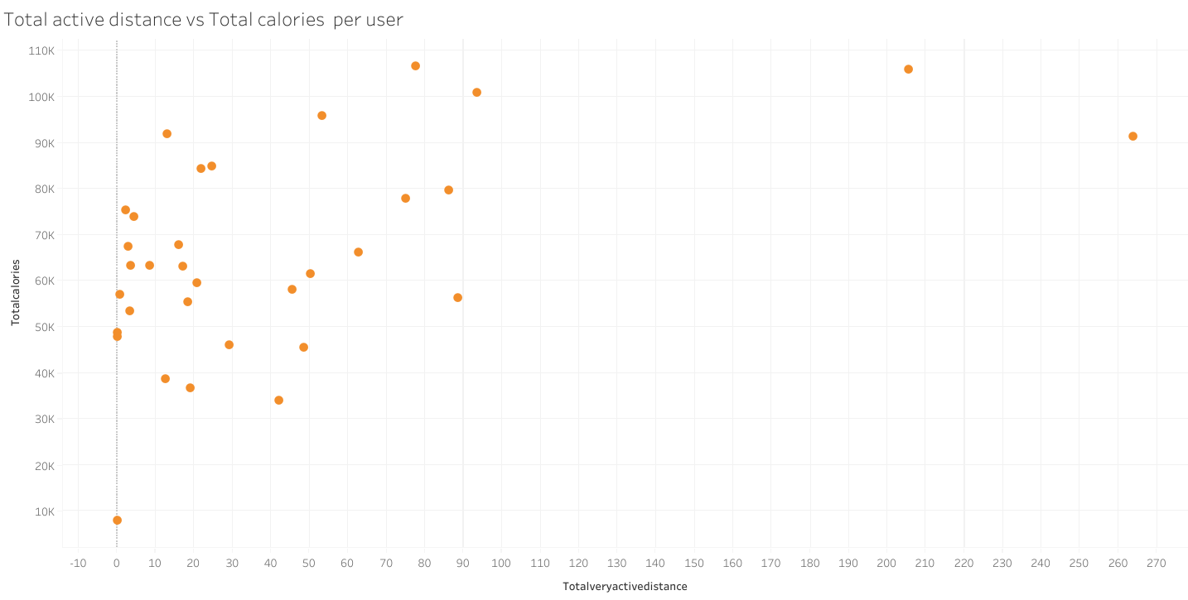
Findings

Slide 13
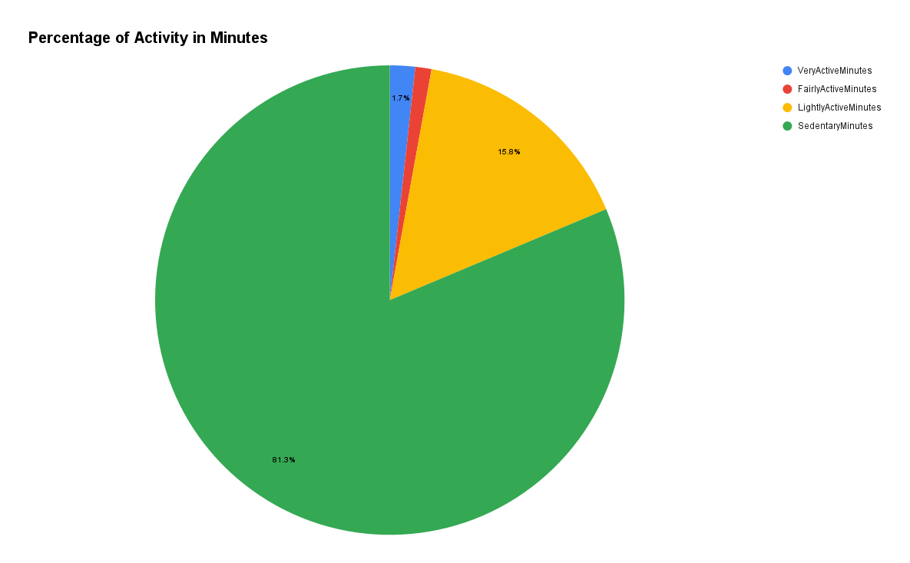
Findings
Notes:
Percentage of Activity in Minutes (Pie chart)
Percentage of sedentary minutes is the highest, meaning people more inactive than active
Percentage of very active and fairly active minutes had the least percentage values

Slide 14
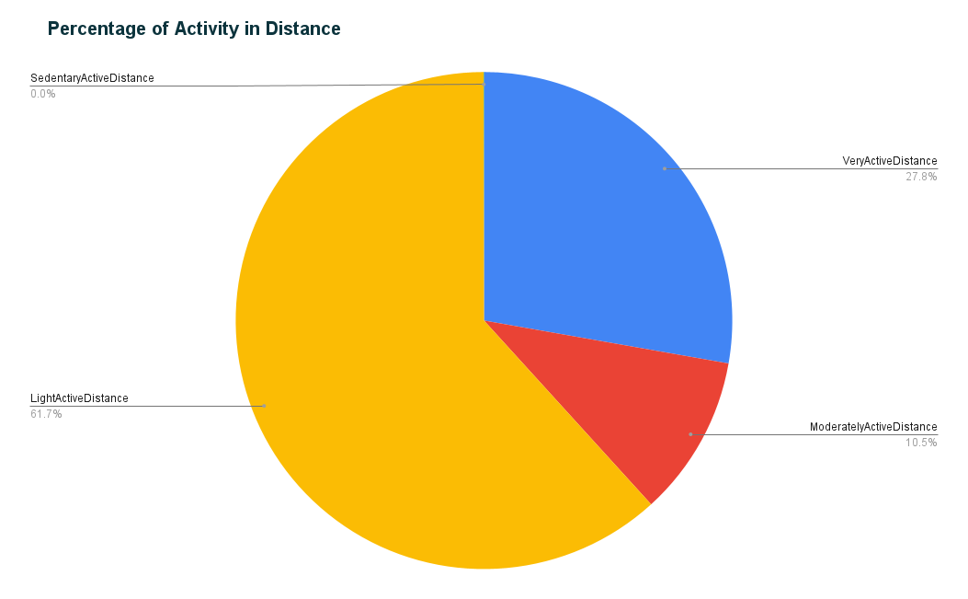
Findings
Notes:
Percentages show that people cover light distances the most

Slide 15
Recommendations
People use the app to track steps, calories and sleep. Some information is missing for these so we can plan to set reminders in the app to have people enter information
The relation between total steps vs calories as well as active minutes vs calories, shows direct proportionality, we can market around this fact
81.3% of people are not very active. We can use this information to set goals and awards for people who reach higher levels of activity
The marketing team can use the information to target people that are not very active and give incentives to use the device more. We can suggest different types of activities and a more accurate way of getting user information like weight.
Notes:
Based on the Analysis, these are a few recommendations

